Slide 1
Lyme on a Budget
Epidemic Answers
Teresa Holler, MS, PA-C, FMAPS
2024

Slide 2
Disclosures
Speakers’s Bureau/Consultant: NutraMedix, LLC
Presentations are intended for educational purposes only and do not replace independent professional judgment. Please discuss your individual treatment needs and decisions with your primary medical provider.

Slide 3
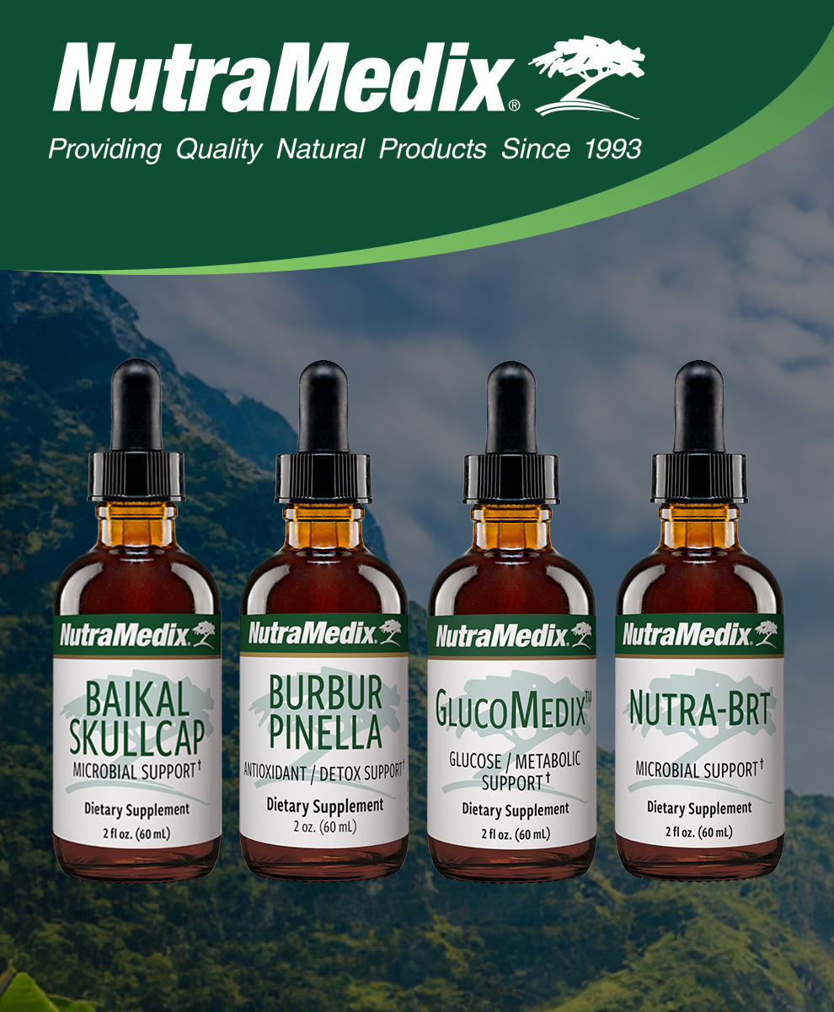

Slide 4
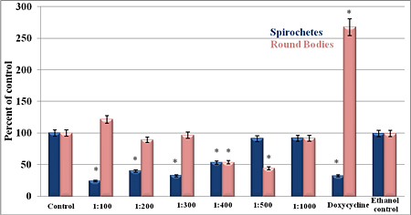
In Vitro Study with Samento + Banderol (Datar et al., 2010)
SAMENTO
Spirochetes – blue
Round bodies – tan
BANDEROL
Spirochetes – blue
Round bodies – tan
Notes:
¹ Datar, A., Kaur, N., Patel, S., Luecke, D. and Sapi, E. (2010) In vitro effectiveness of samento and banderol herbal extracts on the different morphological forms of Borrelia burgdorferi. Townsend Lett 7: 1–4.

Slide 5
Phases of Bacterial Growth
Theophilus, P. A., et al. (2015). Effectiveness of Stevia Rebaudiana Whole Leaf Extract Against the Various Morphological Forms of Borrelia Burgdorferi in Vitro. European journal of microbiology & immunology, 5(4), 268–280.
Spirochetes, round bodies, and biofilms
Stevia whole extract (NM Stevia was “Stevia A”), stevioside, and three antibiotics (doxycycline, cefoperazone, daptomycin)
Stevia A signiﬁcantly eliminated the log phase spirochetes and the stationary phase persisters compared to the control (100% effect for both)
Illustration by : Michał Komorniczak This file has been released into the Creative Commons 3.0. Attribution-ShareAlike (CC BY-SA 3.0), via Wikimedia Commons
Notes:
Each bacterial cell divides into two daughter cells by binary fission.
The exponential or log phase is when the bacterial population is increasing.
The stationary phase (plateau) is when the number of the dividing cells and the number of dying cells are equal.
M•Komorniczak -talk- Illustration by : Michał Komorniczak This file has been released into the Creative Commons 3.0. Attribution-ShareAlike (CC BY-SA 3.0) If you use on your website or in your publication my images (either original or modified), you are requested to give me details: Michał Komorniczak (Poland) or Michal Komorniczak (Poland). For more information, write to my e-mail address: m.komorniczak.pl@gmail.com, CC BY-SA 3.0, via Wikimedia Commons

Slide 6
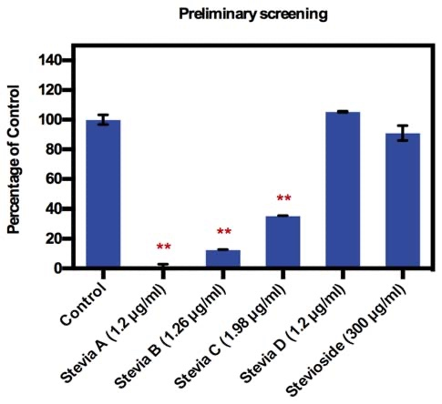
Fig. 1. Preliminary screening of four different extracts of Stevia and Stevioside on the stationary phase of B. burgdorferi after a three-day treatment using the SYBR Green/PI assay. n = 3 ± SD, * p ≤ 0.05,** p ≤ 0.01 compared to the control
(Theophilus et al., 2015)
Notes:
Doxycycline (DoxC) was used as a positive control.
1× PBS and 25% alcohol were used as negative controls, respectively.

Slide 7
Stevia A signiﬁcantly eliminated the log phase spirochetes and the stationary phase persisters compared to the control (100% effect for both)
Theophilus, P. A., et al. (2015). Effectiveness of Stevia Rebaudiana Whole Leaf Extract Against the Various Morphological Forms of Borrelia Burgdorferi in Vitro. European journal of microbiology & immunology, 5(4), 268–280.

Slide 8
Fig. 2C. Susceptibility of log phase (5 days) and stationary phase (8 days) Borrelia burgdorferi to antimicrobial agents after a three-day treatment determined by
(C) Representative live/dead images of log and stationary phase B. burgdorferi to antimicrobial agents taken at 200× magniﬁcation (Scale bar − 100 μm).
(Theophilus et al., 2015)
The log phase and the stationary phase culture treated with Stevia A had only dead cells

Slide 9
Stevia A Reduces Viable Organisms Within Biofilm
-The biofilms treated with cefoperazone, daptomycin, and doxycycline individually were predominantly green indicating viable spirochetes /round bodies within .
-The biofilms treated with the 3 antibiotic combination had a mixture of live and dead cells, with live cells predominating.
-The biofilms treated with Stevia A stained predominantly red, depicting that the biofilm had mainly dead spirochetes /round bodies.
Sapi E, Kaur N, Anyanwu S, Luecke DF, Datar A, Patel S, et al.: Evaluation of in-vitro antibiotic susceptibility of different morphological forms of Borrelia burgdorferi. Infect Drug Resist 4, 97–113 (2011)

Slide 10
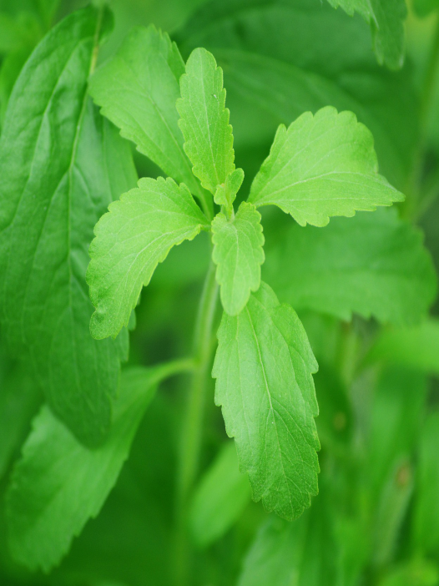
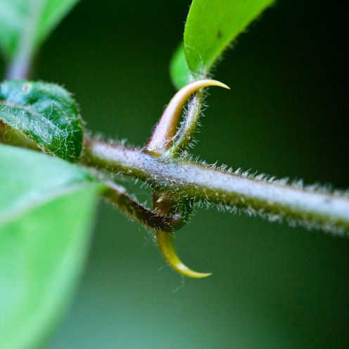
GlucoMedix
Stevia leaf
(Stevia rebaudiana)
Samento Cat’s Claw bark
(Uncaria tomentosa)
Notes:
Stevia picture
https://pixabay.com/photos/stevia-leaf-sugar-plant-sweetness-74187/
Free for commercial use, no attribution required

Slide 11
NutraBRT
Houttuynia
Yu Xing Cao / 鱼腥草
Houttuynia cordata (leaves)
Cumanda
Campsiandra angustifolia (bark)

Slide 12
Lyme and Coinfection Approach
Glucomedix
Nutra BRT
Baikal Skullcap
Burbur / Pinella
Standard Protocol
Start with 1 drop, 2x daily of each herb (1, 2 and 3) at least 30 minutes before food, if possible. Add 1 dropperful of Burbur / Pinella (4) with each dose. Put all the herbs together in a small amount of water. Increase each day by 1 drop, working up slowly to target dose (based on age below).
* Hold the current dose if patient is experiencing new or worsening symptoms (Herxheimer reaction). Try 4 dropperful of Burbur / Pinella added to water bottle and drink throughout the day, if needed. Do not increase dosage until symptoms subside. Once you reach target dose, continue this protocol 2-4 months after symptoms resolve. It is recommended to titrate off each herb one at a time to make sure symptoms do not recur. Adult Dosage (age 12+) target dose of 40 drops, 2x daily. Children’s Dosage (ages 6-12) target dose of 20 drops, 2x daily.
Protocol for Children (ages 2-6) target dose of 10 drops, 2x daily.
INDIVIDUALIZE CARE WITH YOUR PRACTITIONER AND ADJUST AS REQUIRED
IF NO IMPROVEMENT, RECONSIDER YOUR DIAGNOSIS AND/OR TREATMENT APPROACH WITH YOUR MEDICAL PROVIDER

